Slide 1

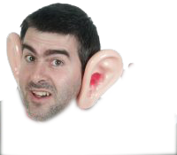
Super-Hearing Aid
DIGITAL
LOGIC
PBL

Slide 2
GROUP MEMBERS:
Bhushan Mahajan----------14BCE1156
Prashant Bharadwaj-------14BCE1177
Rishabh Bhaskaran--------14BCE1042
Shubham Majmudar-------14BCE1069

Slide 3
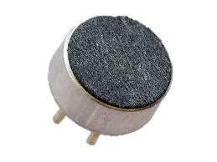
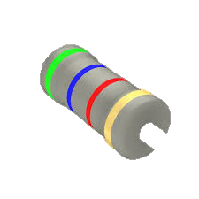
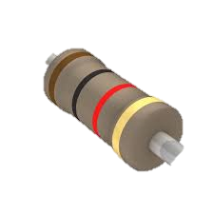
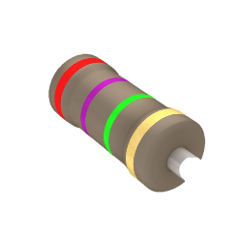
Required Components:
2 X Electret Microphone
4 X 5.6k Resistor
2 X 1k Resistor
2 X 2.7m Resistor

Slide 4
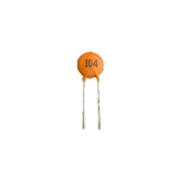
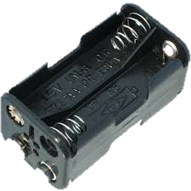
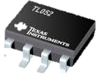
Required Components:
4 X 104 Capacitor
Battery Holder
Op-Amp

Slide 5
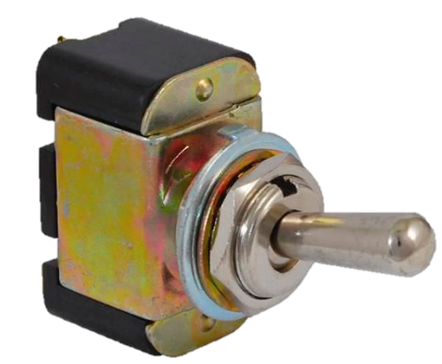
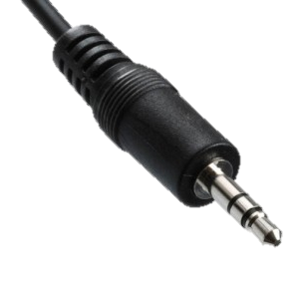
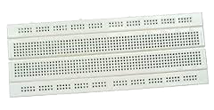
Required Components:
Switch
Headphone Jack
Breadboard

Slide 6
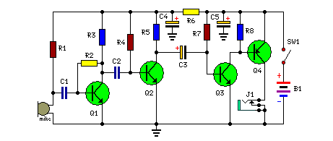
Circuit Diagram:

Slide 7
Procedure:
Solder the components on a chip according to the circuit diagram.
Use a breadboard to access points in same potential.

Slide 8
Uses:
Gives your ears the power to hear inaudible / faintly audible sounds.
But Technically Speaking,
Sounds of low decibels
are amplified to higher decibels,
which makes it possible for the human ear to hear them as they are now in the audible range of loudness (10dB to 10kdB)

Slide 9

Audio Output:
Gulping Sound:
Walking on concrete:
Door Creaking:

Slide 10
THANK YOU

